Slide 1
Agile Communication
Project

Slide 2
Agile Communication
Project
Sprints 1-3

Slide 3
Sprints 1-3 Questions
What is your Velocity for the past 3 sprints?
Our Velocity from the past three sprints is 21.67 (rounded to 2 decimal places).
How do you know your Velocity is correct?
Velocity is the average amount of work a team can complete in a sprint. It is determined by adding up the total number of story points completed in the past sprints and dividing it by the number of sprints. To ensure the accuracy of the velocity, it is important to ensure that the story points assigned to each user story are consistent across sprints, and the team has a shared understanding of what each story point represents. Additionally, any changes in team composition or work processes can affect the velocity, so it is important to regularly review and adjust the velocity as needed.
What would the BURN DOWN chart look like for Sprints 1-3?
The chart is placed to the right.
What would the BURN UP charts look like for Sprints 1-3?
The chart is placed to the right.
How many points do you think the Team should commit to for Sprint 4 and justify your answer?
Based on the velocity of the past three sprints and the remaining story points, it seems reasonable for the team to commit to 20-23 story points for Sprint 4. However, it's important to consider any external factors that may impact the team's ability to complete this amount of work, such as upcoming holidays or team members being unavailable

Slide 4
Agile Communication
Project
Sprint 4

Slide 5
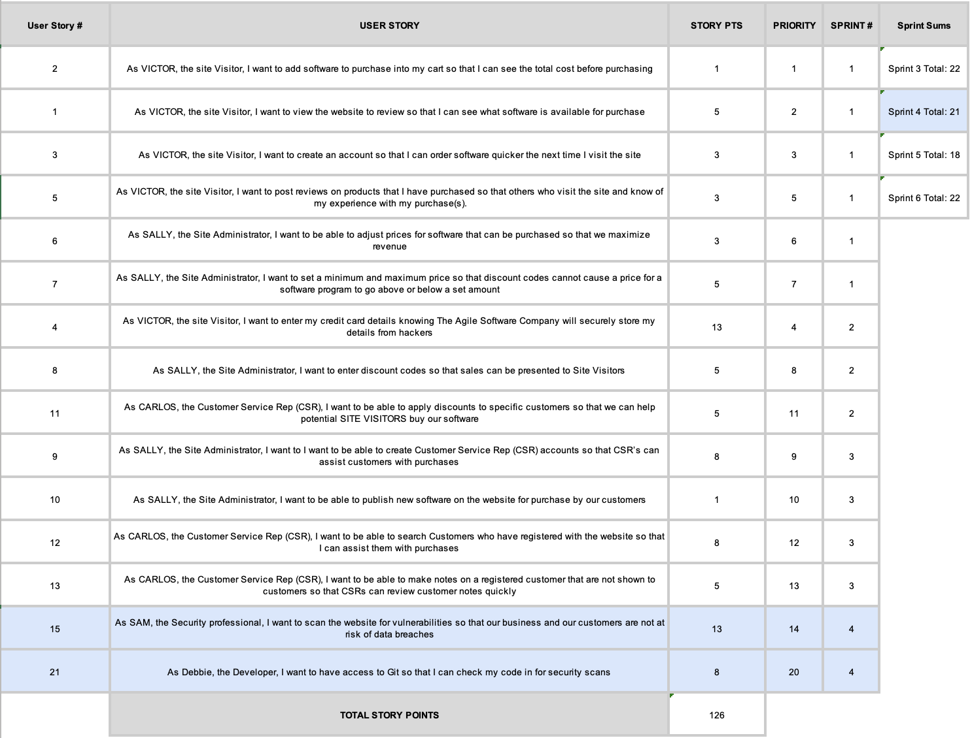

Slide 6
Sprint 4 Questions
What would the BURN DOWN chart look like for Sprints 1-4?
The chart is placed to the right.
What would the BURN UP charts look like for Sprints 1-4?
The chart is placed to the right.
What Risks did you identify in Sprint 4 and how do they affect the project? (Note: These would be your narrative findings)
There are several risks that could affect Sprint 4 and the project, including security vulnerabilities, integration issues with Git, and technical challenges. These risks have the potential to impact the project's timeline, budget, and ability to meet project objectives. The team should monitor and mitigate these risks as much as possible to ensure the security and integrity of the website and protect customer data.
What Theme or Name did you give to Sprint 4?
Security and Vulnerability Scanning.

Slide 7
A-Team
Sprint 4 Name
Security and Vulnerability Scanning
User Stories in Sprint 4
1. Story # 15 with 13 points
2. Story # 21 with 08 points
Total Sprint 4 Points: 21
Narrative: The team aimed to address security risks by conducting website vulnerability scans and providing Git access for code security checks. Results: The team successfully completed the user stories for Sprint 4, which included vulnerability scans and Git access for security checks. Learnings: The team gained knowledge on conducting vulnerability scans and integrating Git for security checks, which will benefit future security efforts. Risks: Technical issues with conducting scans and integrating Git, as well as potential security vulnerabilities discovered, could impact the project timeline and budget.
SPRINT 4 DEMO of Working Product

Slide 8
Agile Communication
Project
Sprint 5

Slide 9
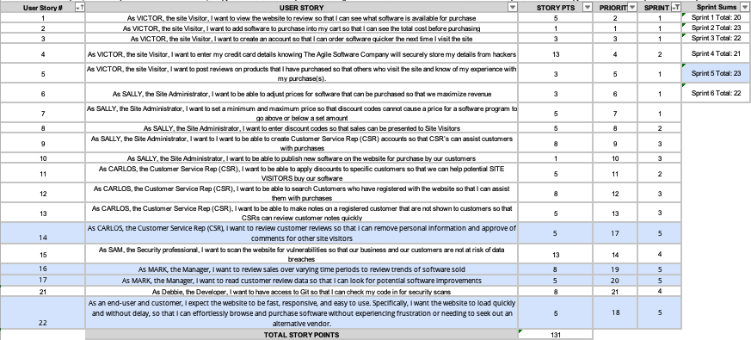

Slide 10
Sprint 5 Questions
What would the BURN DOWN chart look like for Sprints 1-5?
The chart is placed to the right.
What would the BURN UP charts look like for Sprints 1-5?
The chart is placed to the right.
What Risks did you identify in Sprint 5 and how do they affect the project? (Note: These would be your narrative findings)
The identified risk in Sprint 5 is the possibility of not being able to deliver all the user stories by the end of the sprint due to technical challenges and unexpected complications, which could affect the project's timeline and stakeholders' expectations.
How confident are you in delivering all of the user stories by the end of Sprint 6? Justify your answer.
Based on the team's velocity from previous sprints and the remaining story points, it appears feasible for us to commit to 20-23 story points for Sprint 4. However, it's crucial to take into account any external factors that may affect our ability to complete this amount of work, such as upcoming holidays or team members being unavailable. We need to remain flexible and adapt to any changes that may arise to ensure we deliver the most value possible to our customers.

Slide 11
User Stories in Sprint 5
1. Story # 14 with 05 points
2. Story # 16 with 08 points
3. Story # 17 with 05 points 4. Story # 22 with 03 points
Total Sprint 5 Points: 21
SPRINT 5 DEMO of Working Product
A-Team
Sprint 5 Name
Improving User Experience and Sales Analysis
Narrative: Sprint 5 focused on addressing customer feedback for a more responsive website, as well as implementing new features to help the manager review sales and customer review data. Results: The team successfully improved website speed and responsiveness and implemented tools to help the manager better understand sales trends and customer feedback. Learnings: The team learned the importance of prioritizing customer feedback and the value of implementing tools to help managers make data-driven decisions. Risks: The main risk was not being able to address all the customer feedback in a single sprint, but the team managed to focus on the most critical requests.

Slide 12
Agile Communication
Project
Sprint 6

Slide 13
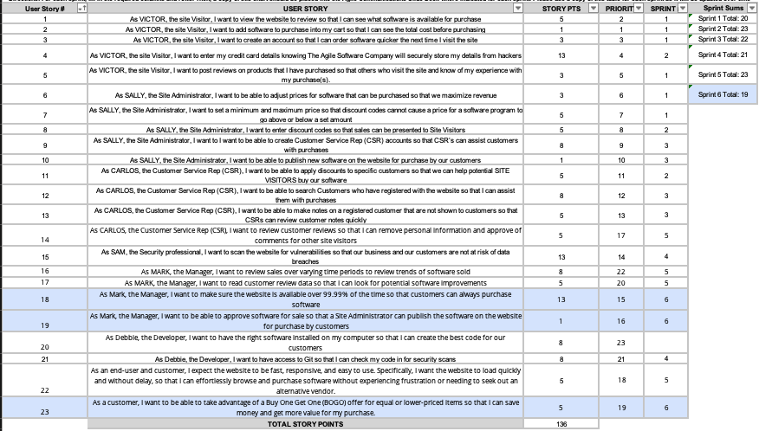

Slide 14
What would the BURN DOWN chart look like for Sprints 1-6?
The chart is placed to the right.
What would the BURN UP charts look like for Sprints 1-6?
The chart is placed to the right.
Was the Team able to complete all the work in the backlog or did you have to adjust what could be delivered? How would you tell this to Management and justify your answer.
Based on the velocity of the previous sprints and the estimated story points for the remaining backlog items, it appeared that the team would be able to complete all the work in the backlog. However, the unexpected global pandemic caused a shift in priorities, and a new user story was added that required immediate attention. The team was able to reprioritize the backlog and complete the new user story, but it resulted in lower-priority items being pushed to future sprints.

Slide 15
User Stories in Sprint 6
1. Story # 18 with 15 points
2. Story # 19 with 01 points
3. Story # 23 with 05 points
Total Sprint 5 Points: 21
SPRINT 5 DEMO of Working Product
A-Team
Sprint 6 Name
Improving User Experience and Sales Analysis
Narrative: In sprint 6, Mark, the Manager, wants to ensure the website is highly available for customers to purchase software by targeting a 99.99% uptime. He also wants to have the ability to approve software for sale so that the Site Administrator can publish the software on the website for customer purchase. Additionally, a BOGO offer will be implemented for equal or lower-priced items to enhance customer value.
Results: The team successfully implemented a high availability strategy for the website, resulting in a 99.99% uptime for customers. Mark was also able to review and approve software for sale, allowing the Site Administrator to publish software for customer purchase. The BOGO offer was also implemented, increasing customer satisfaction and value.
Learnings: The team learned the importance of having a highly available website and the benefits of implementing a BOGO offer to increase customer value. They also gained experience in managing software approvals and the associated processes.
Risks: The risks associated with implementing these stories include potential website downtime during implementation and the possibility of incorrect software approvals, leading to customer dissatisfaction. The team mitigated these risks by conducting thorough testing and validation before deploying any changes.

Slide 16
BVIR for Management Questions
Which charts would you want to include in the BVIR that Management would need and why?
Move the Orange boxes to the correct column below
As the leader of the project, I prioritize transparency in reporting the project status to management, and I believe the Burn up and Burn down charts provide sufficient information on the project's progress without overwhelming management with excessive charts. We faced some disruptions in the project flow during Sprint 4, including a serious security risk that needed immediate resolution. In Sprint 5, we had to address significant user experience issues to prevent customer losses, and in Sprint 6, the pandemic forced us to prioritize the BOGO promo as our top priority. The Burn Up and Burn Down charts are suitable for management as they demonstrate value being delivered, constant and sustainable progress, and the team's adherence to delivering what was promised. The Committed vs Delivered Chart is useful to ensure that the team is not adding unnecessary features and driving up costs or delivering less than expected per sprint. However, I would avoid using the Story Point Cost per Team chart as it may lead us into a complex analysis that could be unproductive.
Included
Not included
Burn Up Charts
Burn Down Charts
Committed vs. Delivered Chart
Story Point Cost per Team

Slide 17
Creating the BVIR for Management
Questions to answer before you start the BVIR
What would tell Management if they want to know the details about actual stories?
[Select from the choices below]
"While I understand that you want to get into individual stories and know all the details, we would prefer that Management spends your valuable time guiding and influencing the Roadmap and direction of the project and leave the story delivery to the Teams you have empowered."
Absolutely, let's get into the details!
No, that is none of your business
Which of the above did you choose (1,2,3) and why?
[Your Answer] I’d choose 1 because it clearly explains and underlines the roles for Management and for the Team in a true Agile working environment.

Slide 18
Creating the BVIR for Management
Questions to answer before you start the BVIR
Is it project considered a failure because backlog items still remain? Explain.
[Your Answer]
The mere presence of backlog items does not necessarily mean that the project is a failure. In Agile project management, it is common for teams to maintain a product backlog that includes items that have not yet been completed or delivered. It is the responsibility of the team to prioritize the backlog items and work on them in the order of their importance, based on the product vision and stakeholder needs. As long as the team is making progress towards completing the most important backlog items, and the product is delivering value to stakeholders, the project can still be considered a success. Therefore, the presence of backlog items alone should not be used as the sole measure of project success or failure.

Slide 19
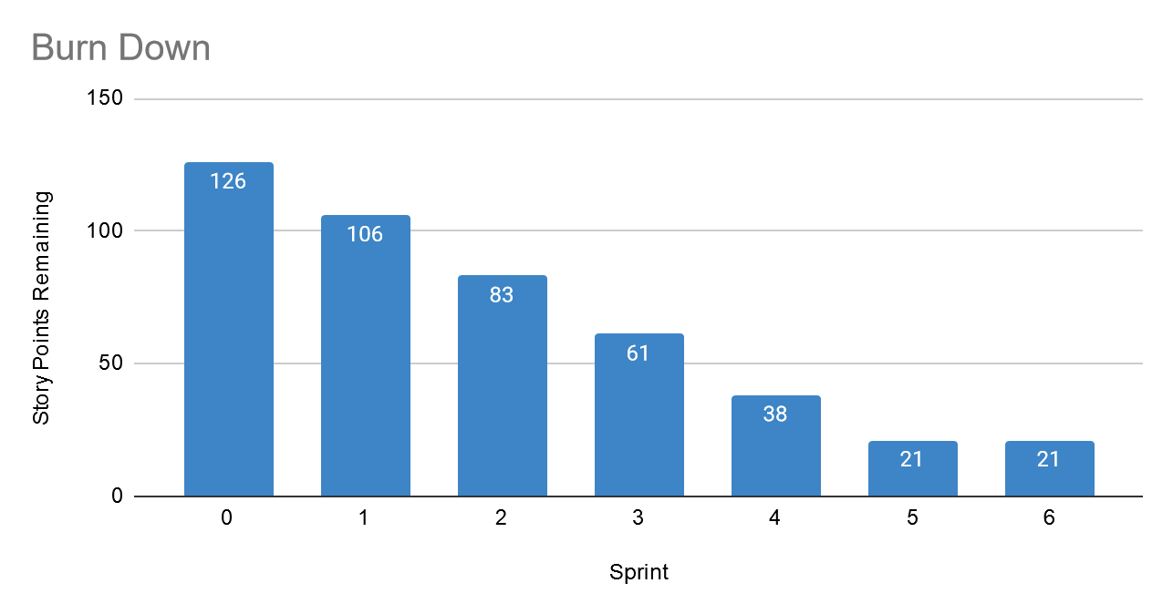
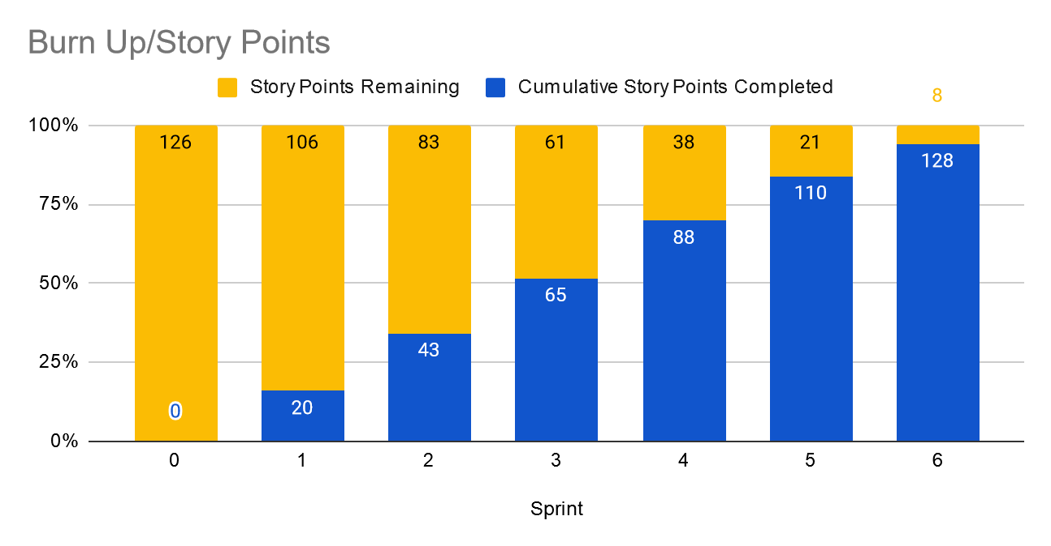
BVIR for Management
[Use this slide to create your BVIR. We have not provided a template for this, you get to decide what it looks like using the information from the previous slide]
Team Name
Roadmap
MVP VISION

Slide 20
BVIR for Management
Good morning everyone, I’m Amnah, the project leader. It's a pleasure to meet you all today. In this meeting, I will present the current status of our project. Our vision is to provide our customers with the fastest and most satisfying way to purchase our software through our new website. I'm thrilled to report that the A-Team has been doing an excellent job in achieving this mission during the last sprint. During the presentation, you'll see the Sprint Burn Down and Burn Up Charts for sprints 1-6. However, we've faced some challenges since sprint 4, which required our immediate attention and disrupted the project flow. In sprint 4, we had to resolve a serious security risk urgently. Following that, in sprint 5, a customer pointed out significant issues with the user experience that would have led to losing customers, so we had to fix them immediately. Finally, in sprint 6, due to the pandemic, we had to prioritize the BOGO promo, which became our top priority. Unfortunately, we have 8 remaining story points, which means the project is not yet completed. These 8 stories are reserved for our final sprint, sprint 7. Thank you for your attention.

Slide 21
Questions from Management (Using Videos would be great!)
Instructions:
Watch the videos in the classroom.
Record your videos or provide your answers below. Remember to justify your answer.
Video # 1: It's understandable that you may have concerns about the MVP not being a perfect product. However, the purpose of an MVP is to launch a functional product with the minimum viable features to test the market and gather feedback. This allows us to iterate and improve the product based on actual user feedback rather than relying solely on assumptions. Waiting for a product to be 100% perfect before releasing it to the market is not feasible, and it may result in missing out on valuable insights that can only be gained through real-world usage. Our goal is to continuously improve the product and work towards a more complete and refined version based on user feedback.
Video # 2: It's important to remember that the Agile approach we are using values flexibility and adaptability over strict adherence to a plan. While we did have a plan, we encountered unforeseen challenges and had to make adjustments to ensure we were still delivering value to the customer. Prioritization and continuous improvement are at the heart of Agile, so we made decisions to focus on the most critical features and address urgent issues as they arose. We believe this approach ultimately led to a better product, even if we didn't complete everything in the original backlog. Video # 3: I understand that you are concerned about the incomplete work. However, we need to consider the feasibility and sustainability of our approach. Burning out our team by forcing them to work around the clock is not a long-term solution, and it may lead to decreased productivity and quality. Additionally, we need to prioritize the most critical tasks and allocate our resources accordingly. In this case, we had to address urgent issues that arose during the project, which affected our original plan. We need to be agile and flexible in our approach to ensure that we can adapt to changing circumstances and deliver a product that meets the needs of our customers. Video # 4: Based on the criticality of the remaining 8 stories and the team's confidence in their ability to complete them within a reasonable timeframe, I would recommend adding a 7th sprint to the project. However, we should also assess the potential impact of this decision on other projects and resources before finalizing the plan.

